Slide 1

Big Data Infrastructure
CS 489/698 Big Data Infrastructure (Winter 2016)
Week 10: Mutable State (2/2)
March 17, 2016
Jimmy Lin
David R. Cheriton School of Computer Science
University of Waterloo
These slides are available at http://lintool.github.io/bigdata-2016w/
This work is licensed under a Creative Commons Attribution-Noncommercial-Share Alike 3.0 United States See http://creativecommons.org/licenses/by-nc-sa/3.0/us/ for details

Slide 2
The Fundamental Problem
We want to keep track of mutable state in a scalable manner
Assumptions:
State organized in terms of many “records”
State unlikely to fit on single machine, must be distributed
(note: much of this material belongs in a distributed systems or databases course)

Slide 3
Motivating Scenarios
Money shouldn’t be created or destroyed:
Alice transfers $100 to Bob and $50 to Carol
The total amount of money after the transfer should be the same
Phantom shopping cart:
Bob removes an item from his shopping cart…
Item still remains in the shopping cart
Bob refreshes the page a couple of times… item finally gone

Slide 4
Motivating Scenarios
People you don’t want seeing your pictures:
Alice removes mom from list of people who can view photos
Alice posts embarrassing pictures from Spring Break
Can mom see Alice’s photo?
Why am I still getting messages?
Bob unsubscribes from mailing list
Message sent to mailing list right after
Does Bob receive the message?

Slide 5
Three Core Ideas
Partitioning (sharding)
For scalability
For latency
Replication
For robustness (availability)
For throughput
Caching
For latency
Need distributed transactions!
Need replica coherence protocol!
Need cache coherence protocol!
How to address?

Slide 6

Relational Databases
… to the rescue!
Source: images.wikia.com/batman/images/b/b1/Bat_Signal.jpg

Slide 7
What do RDBMSes provide?
Relational model with schemas
Powerful, flexible query language
Transactional semantics: ACID
Rich ecosystem, lots of tool support

Slide 8
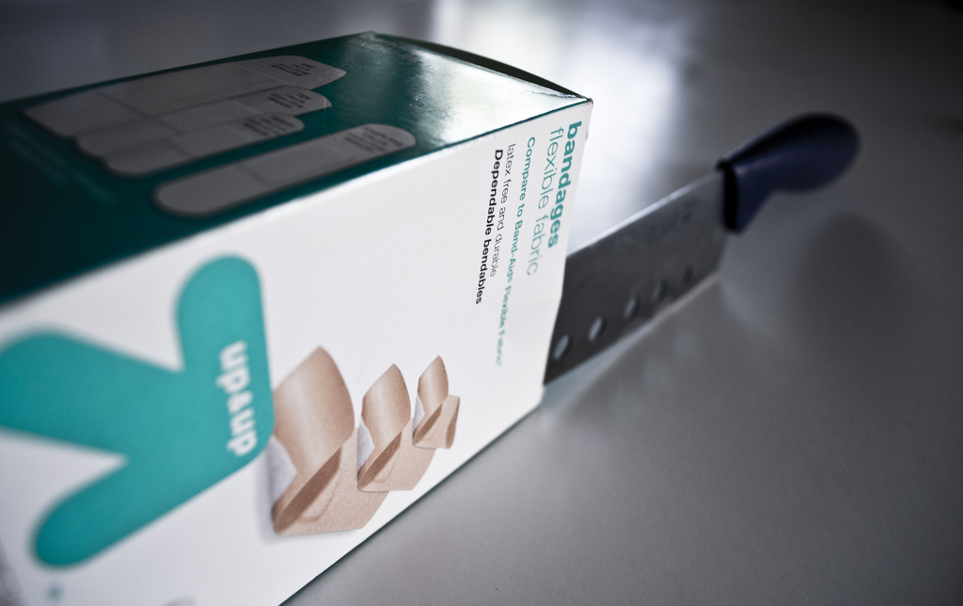
RDBMSes: Pain Points
Source: www.flickr.com/photos/spencerdahl/6075142688/

Slide 9
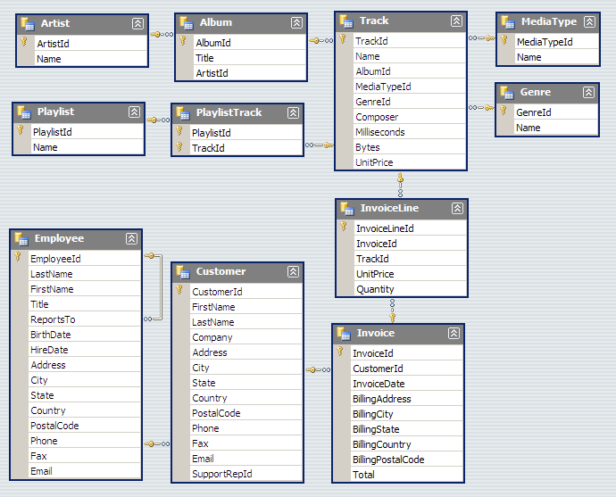
#1: Must design up front, painful to evolve
Note: Flexible design doesn’t mean no design!

Slide 10
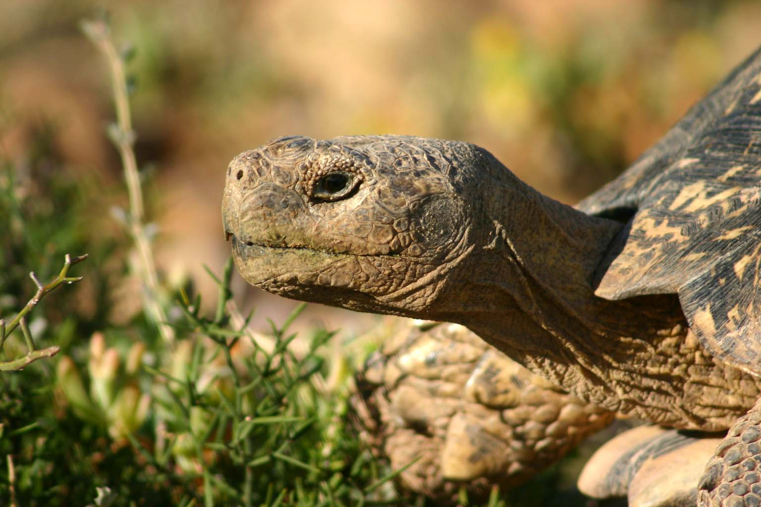
#2: Pay for ACID!
Source: Wikipedia (Tortoise)

Slide 11

#3: Cost!
Source: www.flickr.com/photos/gnusinn/3080378658/

Slide 12
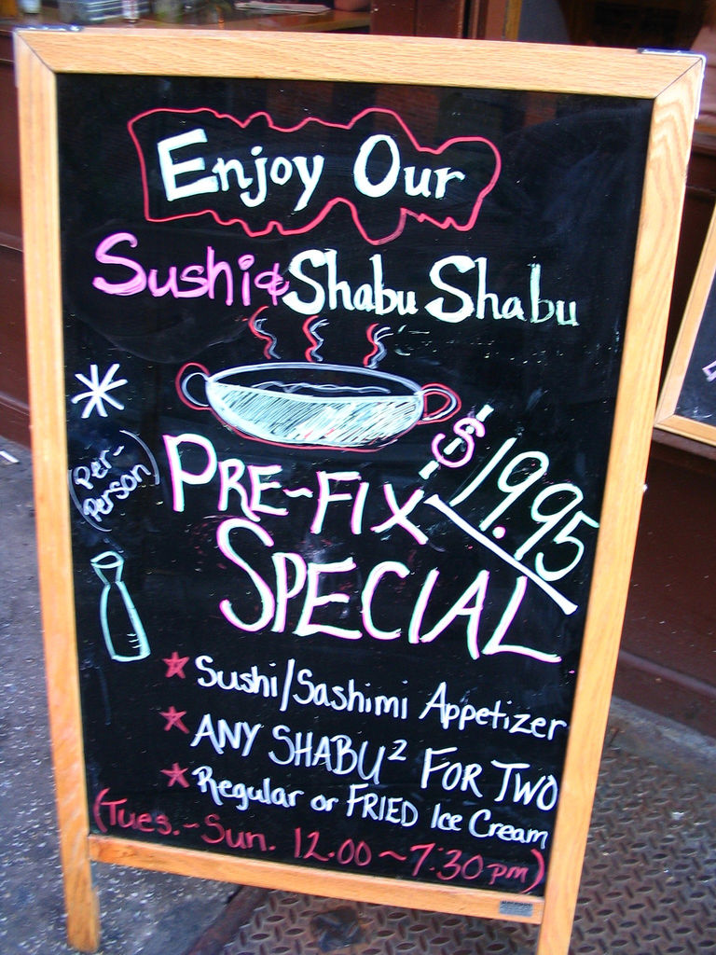
What do RDBMSes provide?
Relational model with schemas
Powerful, flexible query language
Transactional semantics: ACID
Rich ecosystem, lots of tool support
What if we want a la carte?
Source: www.flickr.com/photos/vidiot/18556565/

Slide 13
Features a la carte?
What if I’m willing to give up consistency for scalability?
What if I’m willing to give up the relational model for something more flexible?
What if I just want a cheaper solution?

Slide 14
Three Core Ideas
Partitioning (sharding)
For scalability
For latency
Replication
For robustness (availability)
For throughput
Caching
For latency
Need distributed transactions!
Need replica coherence protocol!
Need cache coherence protocol!
Motivating application?

Slide 15
How do RDBMSes do it?
Transactions on a single machine: (relatively) easy!
Partition tables to keep transactions on a single machine
Example: partition by user
What about transactions that require multiple machine?
Example: transactions involving multiple users
Solution: Two-Phase Commit

Slide 16
2PC: Sketch
Okay everyone, PREPARE!
YES
Good. COMMIT!
ACK!
YES
DONE!
ACK!
Coordinator
YES
ACK!
subordinates

Slide 17
2PC: Sketch
Okay everyone, PREPARE!
YES
ABORT!
YES
Coordinator
NO
subordinates

Slide 18
2PC: Sketch
Okay everyone, PREPARE!
YES
Good. COMMIT!
ACK!
YES
ACK!
Coordinator
YES
subordinates

Slide 19
2PC: Assumptions and Limitations
Assumptions:
Persistent storage and write-ahead log at every node
WAL is never permanently lost
Limitations:
It’s blocking and slow
What if the coordinator dies?
Beyond 2PC: Paxos!
(details beyond scope of this course)

Slide 20
Remember this?

Slide 21
“Unit of Consistency”
Single record:
Relatively straightforward
Complex application logic to handle multi-record transactions
Arbitrary transactions:
Requires 2PC
Middle ground: entity groups
Groups of entities that share affinity
Co-locate entity groups
Provide transaction support within entity groups
Example: user + user’s photos + user’s posts etc.
Where have we learned this trick before?

Slide 22
Three Core Ideas
Partitioning (sharding)
For scalability
For latency
Replication
For robustness (availability)
For throughput
Caching
For latency
Need distributed transactions!
Need replica coherence protocol!
Need cache coherence protocol!

Slide 23
CAP “Theorem”
(Brewer, 2000)
Consistency
Availability
Partition tolerance
… pick two

Slide 24
CAP Tradeoffs
CA = consistency + availability
E.g., parallel databases that use 2PC
AP = availability + tolerance to partitions
E.g., DNS, web caching

Slide 25
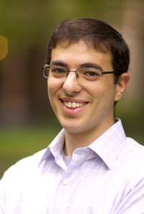
Is this helpful?
CAP not really even a “theorem” because vague definitions
More precise formulation came a few years later
Wait a sec, that doesn’t sound right!
Source: Abadi (2012) Consistency Tradeoffs in Modern Distributed Database System Design. IEEE Computer, 45(2):37-42

Slide 26
Abadi Says…
CP makes no sense!
CAP says, in the presence of P, choose A or C
But you’d want to make this tradeoff even when there is no P
Fundamental tradeoff is between consistency and latency
Not available = (very) long latency

Slide 27
Replication possibilities
Update sent to all replicas at the same time
To guarantee consistency you need something like Paxos
Update sent to a master
Replication is synchronous
Replication is asynchronous
Combination of both
Update sent to an arbitrary replica
All these possibilities involve tradeoffs!
“eventual consistency”

Slide 28
Move over, CAP
PACELC (“pass-elk”)
PAC
If there’s a partition, do we choose A or C?
ELC
Otherwise, do we choose latency or consistency?

Slide 29
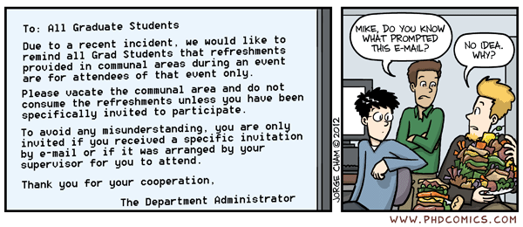
Morale of the story: there’s no free lunch!
Source: www.phdcomics.com/comics/archive.php?comicid=1475

Slide 30
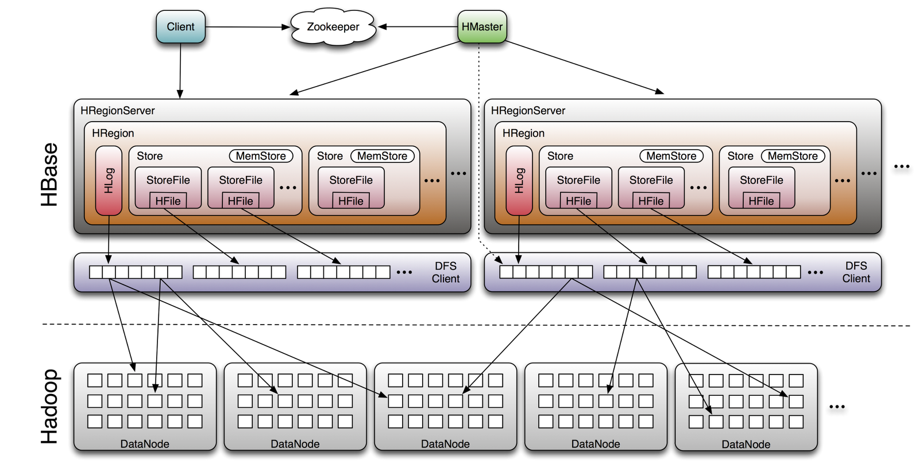
HBase
Image Source: http://www.larsgeorge.com/2009/10/hbase-architecture-101-storage.html

Slide 31
Three Core Ideas
Partitioning (sharding)
For scalability
For latency
Replication
For robustness (availability)
For throughput
Caching
For latency
Need distributed transactions!
Need replica coherence protocol!
Need cache coherence protocol!
This is really hard!

Slide 32
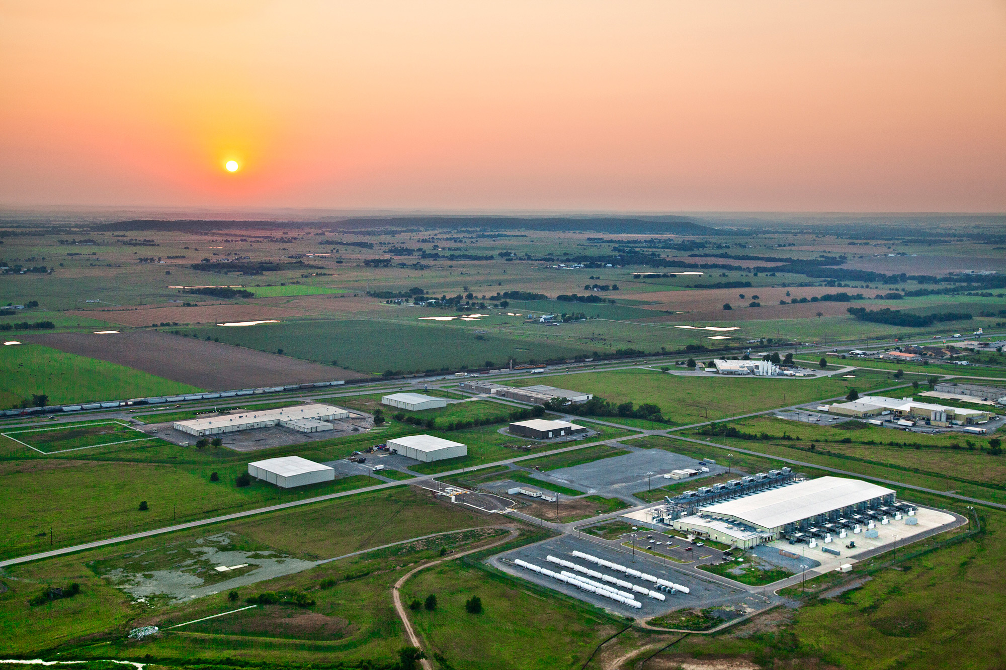
Now imagine multiple datacenters…
What’s different?
Source: Google

Slide 33
Three Core Ideas
Partitioning (sharding)
For scalability
For latency
Replication
For robustness (availability)
For throughput
Caching
For latency
Need distributed transactions!
Need replica coherence protocol!
Need cache coherence protocol!

Slide 34
Facebook Architecture
memcached
MySQL
Read path:
Look in memcached
Look in MySQL
Populate in memcached
Write path:
Write in MySQL
Remove in memcached
Subsequent read:
Look in MySQL
Populate in memcached
✔
Source: www.facebook.com/note.php?note_id=23844338919

Slide 35
Facebook Architecture: Multi-DC
memcached
memcached
MySQL
MySQL
Replication lag
California
Virginia
User updates first name from “Jason” to “Monkey”.
Write “Monkey” in master DB in CA, delete memcached entry in CA and VA.
Someone goes to profile in Virginia, read VA slave DB, get “Jason”.
Update VA memcache with first name as “Jason”.
Replication catches up. “Jason” stuck in memcached until another write!
Source: www.facebook.com/note.php?note_id=23844338919

Slide 36
Facebook Architecture
memcached
memcached
MySQL
MySQL
Replication
= stream of SQL statements
California
Virginia
Solution: Piggyback on replication stream, tweak SQL
REPLACE INTO profile (`first_name`) VALUES ('Monkey’) WHERE `user_id`='jsobel' MEMCACHE_DIRTY 'jsobel:first_name'
Source: www.facebook.com/note.php?note_id=23844338919

Slide 37
Three Core Ideas
Partitioning (sharding)
For scalability
For latency
Replication
For robustness (availability)
For throughput
Caching
For latency
Need distributed transactions!
Need replica coherence protocol!
Need cache coherence protocol!

Slide 38
Yahoo’s PNUTS
Yahoo’s globally distributed/replicated key-value store
Provides per-record timeline consistency
Guarantees that all replicas provide all updates in same order
Different classes of reads:
Read-any: may time travel!
Read-critical(required version): monotonic reads
Read-latest

Slide 39
PNUTS: Implementation Principles
Each record has a single master
Asynchronous replication across datacenters
Allow for synchronous replicate within datacenters
All updates routed to master first, updates applied, then propagated
Protocols for recognizing master failure and load balancing
Tradeoffs:
Different types of reads have different latencies
Availability compromised when master fails and partition failure in protocol for transferring of mastership

Slide 40
Three Core Ideas
Partitioning (sharding)
For scalability
For latency
Replication
For robustness (availability)
For throughput
Caching
For latency
Need distributed transactions!
Have our cake and eat it too?
Need replica coherence protocol!
Need cache coherence protocol!

Slide 41
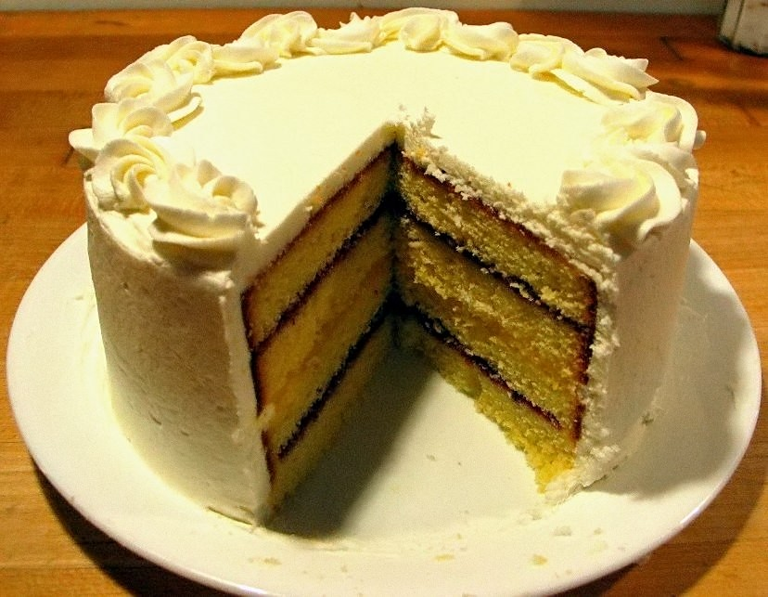
Source: Wikipedia (Cake)

Slide 42
Google’s Megastore
Source: Baker et al., CIDR 2011

Slide 43
Google’s Spanner
Features:
Full ACID translations across multiple datacenters, across continents!
External consistency (= linearizability): system preserves happens-before relationship among transactions
How?
Given write transactions A and B, if A happens-before B, then timestamp(A) < timestamp(B)
Source: Llyod, 2012

Slide 44
Source: Llyod, 2012

Slide 45
Source: Llyod, 2012

Slide 46
Source: Llyod, 2012

Slide 47
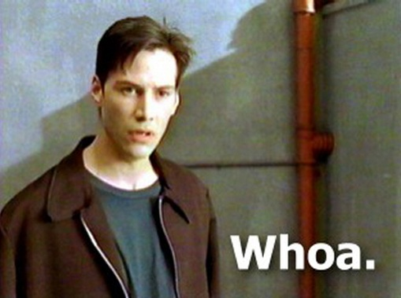
What’s the catch?
Source: The Matrix

Slide 48
Morale of the story: there’s no free lunch!
Source: www.phdcomics.com/comics/archive.php?comicid=1475

Slide 49

Questions?
Source: Wikipedia (Japanese rock garden)

